Slide 1


Slide 2


Tonight’s Topics:
College prep/post-secondary options timeline
College considerations
Breakout sessions (two-session rotation):
  Career & College Promise (CCP)
  College: Getting Started
  Career Exploration & Community College Options

Slide 3
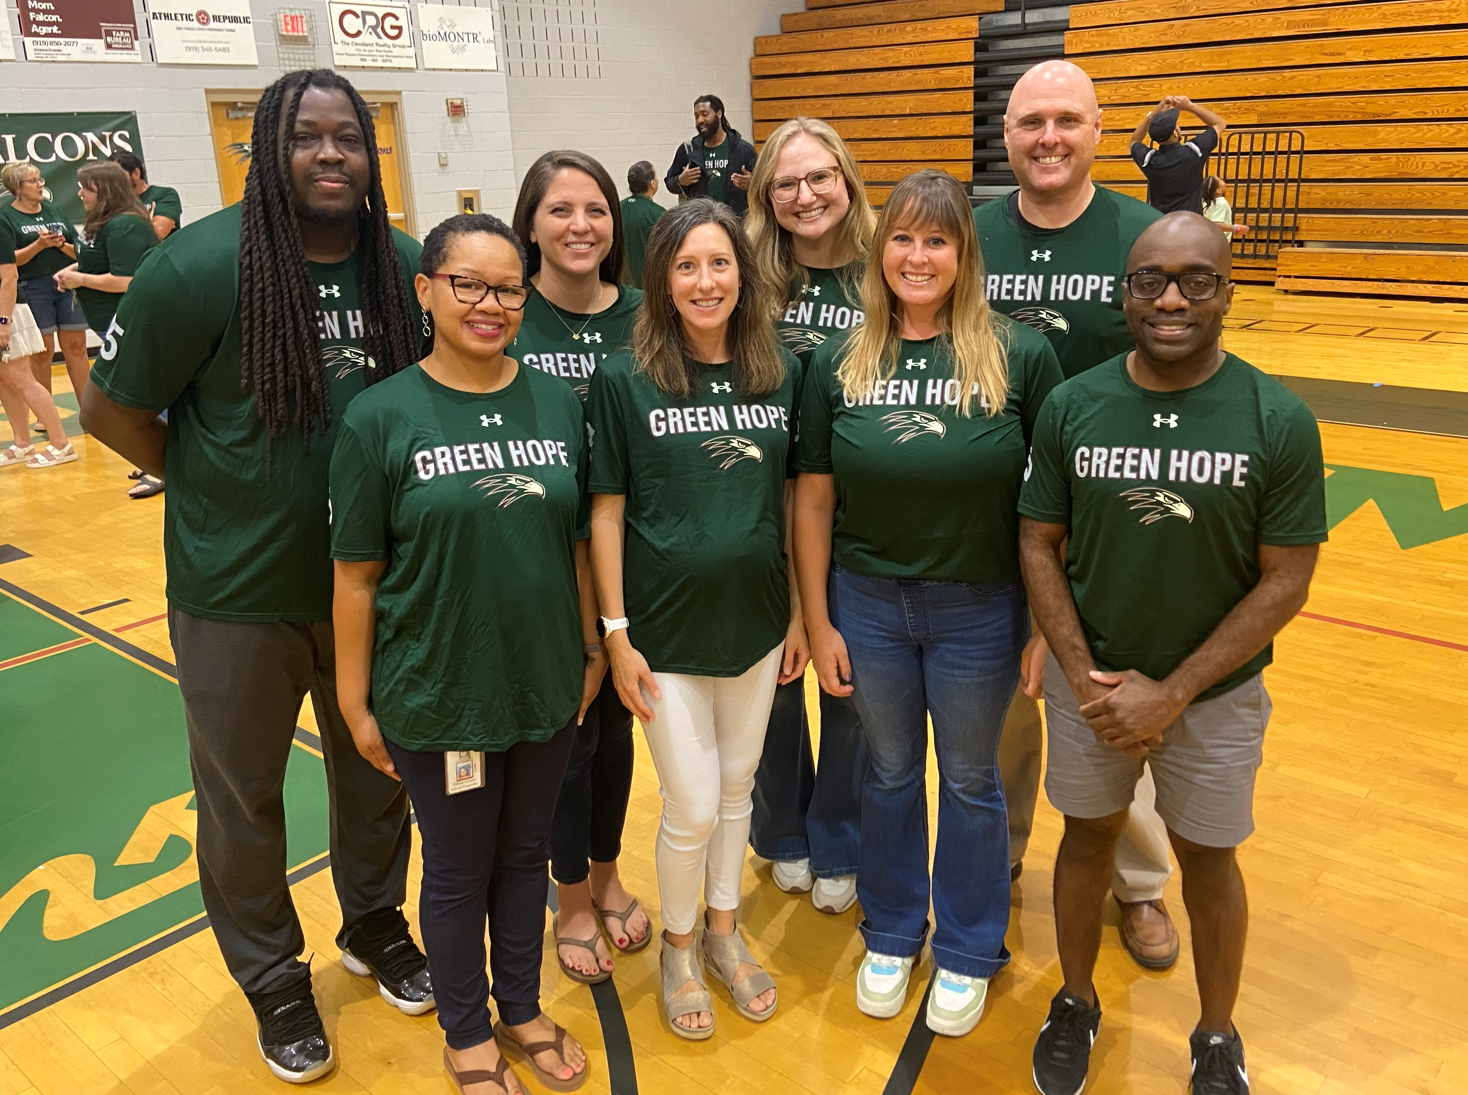
We are Student Services:
Krisi Font | A – Dang
Cory Teasley | Dani – Jh
Katherine Tarr | Ji – Naj
Emma Bumgardner | Nak – She
Jessica Merry | Shi - Z
Justin McIntyre | Dean of Students
Tiffany Cooper | SAP Counselor
Angie Murrane | Admin Assistant
Cathy Dillon | Registrar
Dan McGrogan | Psychologist

Slide 4
Graduation Requirements:
Subject | Credits
English | 4
Math | 4
Science | 3
Social Studies | 4
Healthful Living | 1
Electives | 10
 | 26 Total
World Languages:
✗ Not required for graduation
✓ Two levels of the same language strongly suggested for most 4-year college admissions

Slide 5
Lunch Presentations
Junior Conferences
Support
From
Student
Services
Senior Family Night
Senior Conferences
Senior Lunch Presentations

Slide 6
  How to search for colleges: Feb. 12th
    ^{Featuring: NCSU, ECU, UNC-C}
  College essay tips and techniques: March 27th
  Featuring: UNC-Chapel Hill
Lunch Presentations
Junior Conferences
Senior Family Night
Senior Conferences
Senior Lunch Presentations

Slide 7
Lunch Presentations
February 3rd – 21st
Meet individually with your counselor.
Discuss post-secondary planning, courses for senior year, and answer questions.
Sign-ups will be in the Student Services Canvas.
Junior Conferences
Senior Family Night
Senior Conferences
Senior Lunch Presentations

Slide 8
Lunch Presentations
Typically the 1st week of September
Application platforms
Requesting transcripts
Q&A with college representatives
Junior Conferences
Senior Family Night
Senior Conferences
Senior Lunch Presentations

Slide 9
Graduation progress
Post-secondary plans
College application help
Scholarships
Essay help
Answer questions
Lunch Presentations
Junior Conferences
Senior Family Night
Senior Conferences
Senior Lunch Presentations

Slide 10
Lunch Presentations
Common App Walk-Through
College essay writing workshop
Financial Aid & Scholarships
Junior Conferences
Senior Family Night
Senior Conferences
Senior Lunch Presentations

Slide 11





What should we be doing now to prepare for our future?

Slide 12
Fall/Winter of Junior Year:
Begin exploring college and other post-secondary options.
Determine if your next step will be a 4-year university, community college, trade school, military, or the job force.
Bigfuture.collegeboard.org

Slide 13
Fall/Winter of Junior Year:
Research majors and colleges offering your intended major.
Volunteer or seek leadership positions.
Investigate ACT/SAT requirements.
Military/ROTC scholarships start junior year.

Slide 14
Spring of Junior Year:
Start visiting potential colleges.
Take the SAT/ACT, if necessary.
Talk with teachers about course recommendations for senior year.
Take AP exams, if applicable.

Slide 15
Spring of Junior Year:
Meet with your counselor for your junior conference.
Research summer opportunities:
  CFNC has a searchable list of opportunities under “College Preparation Opportunities.”

Slide 16
Summer Junior Year:
Attend college tours or open house opportunities.
Begin your Common App essay.
Remember this is the last summer for enrichment opportunities to show up on your college applications.

Slide 17
Extracurricular Involvement
Remember just joining versus true involvement: “quality over quantity.”
Sustained involvement.
Consider leadership positions.

Slide 18
Fall of Senior Year:
Come to Senior Family Night!
Complete college applications:
  Early deadlines tend to be October 15 – November 15
Attend your senior counselor conference.
Senior year course selections are strongly considered in admissions!

Slide 19
Spring of Senior Year:
Apply to any regular decision choices by January 15th.
Finalize scholarship applications.
Apply to community colleges.
Start job applications.

Slide 20
Spring of Senior Year:
College decision submitted
by May 1st!!!
Many colleges will want final senior year transcripts.

Slide 21

What are colleges looking for?
Performance: How well have you done? What are you grades and growth?
Program: How rigorous is your coursework?
Participation: Commitments outside of the classroom.
Potential: Shown in standardized tests.
Personality: Shown in essay and teacher/counselor recommendations. BE YOURSELF- in your own words!

Slide 22
What are colleges looking for?
Program: How rigorous is your coursework?
Performance: How well have you done? What are you grades and growth?
Potential: Shown in standardized tests.
Participation: Commitments outside of the classroom.
Personality: Shown in essay and teacher/counselor recommendations. BE YOURSELF- in your own words!

Slide 23
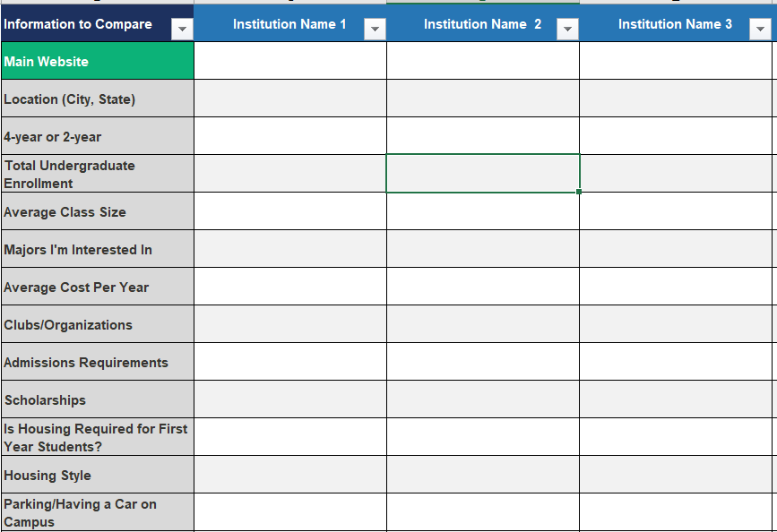
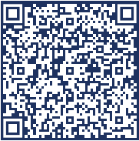
What Should I Look For in a College?
ACT College Comparison Worksheet

Slide 24

Session 1 6:35 – 7:00 | Session 2 7:05 – 7:30
Career and College Promise (CCP) Room: Auditorium | Career and College Promise (CCP) Room: Auditorium
College: Getting Started Room: Media Center | College: Getting Started Room: Media Center
Career Exploration & Community College Options Room: 200 | Career Exploration & Community College Options Room: 200

